Slide 1
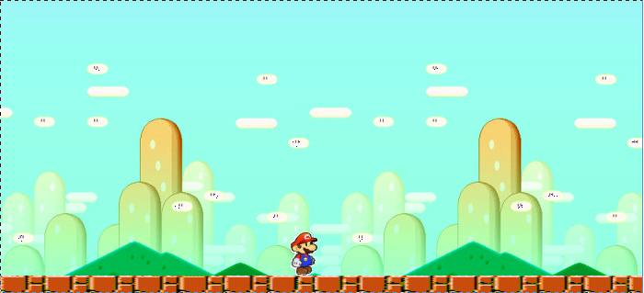
SUPER MARIO BROS. PYGAME
BY: ADOLFO PALLARES-ACEVES AND PAPA NII VANDERPUYE

Slide 2
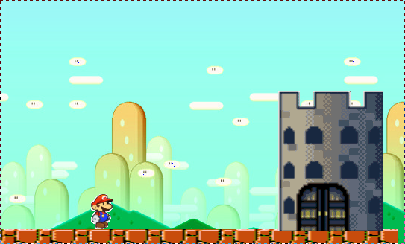
GAME DESCRIPTION
The original game has two characters, which are Mario and Luigi, and it contains many levels/worlds.
Our version of the game is just one level/world and it is only one player, which is Mario.
Mario goes from one end to the other end of the world in order to save the princess.
Pygame is the module we used to create this game.

Slide 3
THE .PY'S CREATED
The following are the .py programs created/used in order to create papapa.py:
  pygame.py(used)
  bricks.py(created/used)
  enemy.py(created/used)
  ground.py(created/used)
  mario.py(created/used)

Slide 4
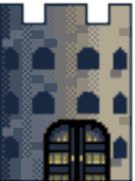



BRICKS.PY
bricks.py is the module that creates the stairs and all of the bricks/question bricks during the entire game.
All the classes in this module are sub classes to pygame.sprite.Sprite
The following are the sub classes:
  Boundary
  Coins
  Bricks
  QuestionBricks
  brickStairs1-brickStairs5
  Tunnel
  Castel1 and Castle2

Slide 5


ENEMY.PY
enemy.py is the module that creates all of Mario's enemies throughout the game
All the classes in this module are sub classes to pygame.sprite.Sprite
The following are the sub classes:
  Plants
  Ugly
  Footy
  Turtle(the animal)

Slide 6
GROUND.PY
ground.py is the module that creates all of the brick floor that Mario steps on.
All the classes in this module are sub classes to pygame.sprite.Sprite
The following are the sub classes:
  Ground1
  Ground2
  Ground3
  Ground4
  Ground5

Slide 7
MARIO.PY
mario.py is the module that creates Mario and makes it possible for Mario to interact with all of its surroundings.
All the classes in this module are sub classes to pygame.sprite.Sprite
The following are the sub classes:
  Mario

Slide 8
SUPERMARIO.PY
This is the main program used in order to play the game.
The score class in this module is a sub class to pygame.sprite.Sprite
The Level class is the class that draws all of the objects that draw out the enemies, bricks, castles, coins
The Level class has a sub class called Level_01
  The sub class is what lays out all the bricks, question bricks, and castles.

Slide 9

CHALLENGES
The following are some challenges that we went through:
  Displaying Text
  The games pace
  Knowing where the Mario Die sound should go
  The ability of coins being created by the bricks and bouncing up when Mario hit the question brick.
  Creating the die function for the enemies

Slide 10
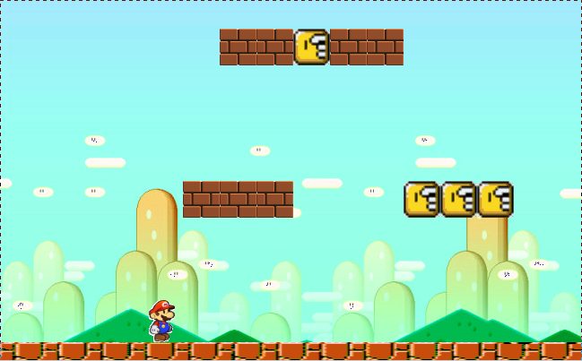
NOW TIME TO LOOK AT SOME CODE!!!

